Slide 1

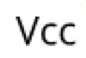
Potentiometers can be hooked up in either orientation
potentiometers
Resistive material
Resistive material
Wiper
Wiper
Source: https://en.wikipedia.org/wiki/Potentiometer

Slide 2
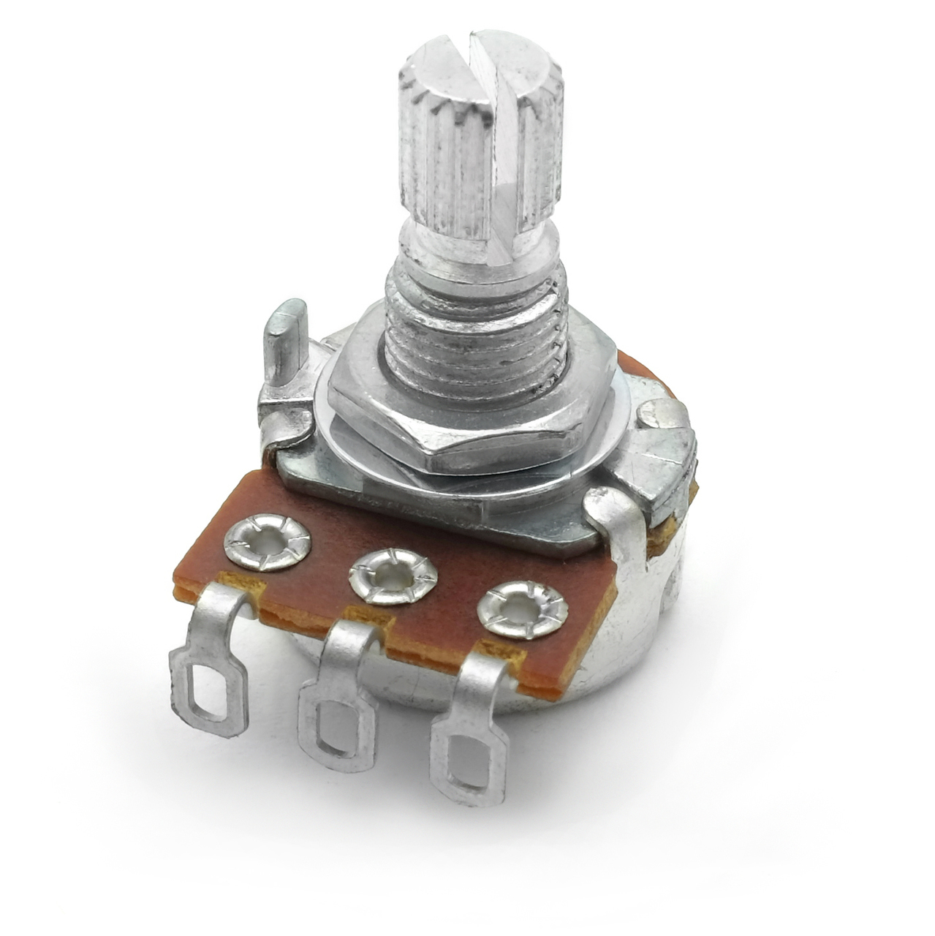
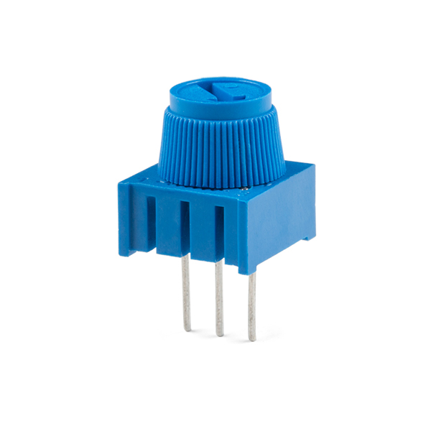
`
`

Slide 3
`
`

Slide 4
`
`

Slide 5
Resistive material
Wiper turns with dial
1
3
`
`
1
1
2
3
2
3
1
2
3
2
Wiper contact
Wiper contact
Wiper contact
Wiper contact

Slide 6
Resistive material
Wiper turns with dial
1
3
`
`
1
2
3
2
Wiper contact
Wiper contact

Slide 7
1
3
`
`
1
2
3
2
Wiper contact
Wiper contact

Slide 8
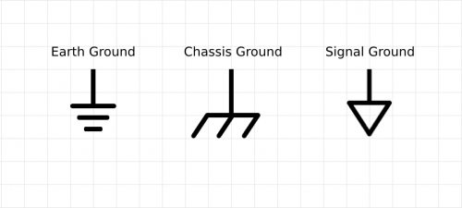
Vcc
3
Vcc
`
`
3
GND
GND
Notes:
Animation partially inspired by: https://youtu.be/fg9No42IjnM?t=114
How Potentiometer works : Linear and Rotary type Potentiometer
by EasyMechLearn

Slide 9
A potentiometer is a three-leg resistor with a sliding or rotating contact that can be used to dynamically vary resistance.
Resistive material
Wiper turns with dial
1
3
`
`
1
2
3
2
Wiper contact
Wiper contact

Slide 10
Here, we have a 10kΩ potentiometer
5K
0K
2.5K
5K
7.5K
10K
2.5K
7.5K
1
3
`
`
0K
10K
1
2
3
2
Wiper contact
Wiper contact

Slide 11
5K
0K
2.5K
5K
7.5K
10K
2.5K
7.5K
1
3
`
`
0K
10K
1
2
3
2
The resistance between 1 and 2 changes depending on wiper position. Let’s call this R₁.

Slide 12
5K
0K
2.5K
5K
7.5K
10K
2.5K
7.5K
1
3
`
`
0K
10K
1
2
3
2
The resistance between 1 and 2 changes depending on wiper position. Let’s call this R₁.

Slide 13
5K
0K
2.5K
5K
7.5K
10K
2.5K
7.5K
1
3
`
`
0K
10K
1
2
3
2
The resistance between Legs 1 and 2 changes depending on wiper position. Let’s call this R₁.

Slide 14
5K
0K
2.5K
5K
7.5K
10K
2.5K
7.5K
R₁
1
3
R₁
`
`
0K
10K
1
2
3
2
The resistance between Legs 1 and 2 changes depending on wiper position. Let’s call this R₁.

Slide 15
5K
R₂
0K
2.5K
5K
7.5K
10K
2.5K
7.5K
R₁
1
3
R₁
R₂
`
`
0K
10K
1
2
3
2
Simultaneously, the wiper also affects the resistance between Legs 2 and 3. Let’s call this R₂.

Slide 16
This circuit is known as a voltage divider because the voltage at Leg 2 is divided between R₁ and R₂
5K
R₂
0K
2.5K
5K
7.5K
10K
2.5K
7.5K
R₁
1
3
R₁
R₂
`
`
0K
10K
1
2
3
2
Simultaneously, the wiper also affects the resistance between Legs 2 and 3. Let’s call this R₂.

Slide 17
5K
0K
2.5K
5K
7.5K
10K
2.5K
7.5K
1
3
`
`
0K
10K
1
2
3
2
Regardless of wiper position, note that (R_{tot}) between Legs 1 and 3 is always 10kΩ (this is a 10kΩ potentiometer)

Slide 18
5K
R₂
0K
2.5K
5K
7.5K
10K
2.5K
7.5K
R₁
1
3
R₁
R₂
`
`
0K
10K
1
2
3
2
And that R_{tot} always equals R₁ + R₂
R₁ + R₂
+ R₂

Slide 19
Let’s try a few wiper positions
5K
R₂
0K
2.5K
5K
7.5K
10K
2.5K
7.5K
R₁
1
3
R₁
R₂
`
`
0K
10K
1
2
3
2
Wiper contact
Wiper contact

Slide 20
5K
0K
2.5K
5K
7.5K
10K
2.5K
7.5K
1
3
`
`
0K
10K
1
2
3
2
Wiper contact
Wiper contact

Slide 21
5K
0K
2.5K
5K
7.5K
10K
2.5K
7.5K
1
3
R₁=0Ω
R₂=10KΩ
`
`
0K
10K
1
2
3
2
Wiper contact
Wiper contact

Slide 22
5K
0K
2.5K
5K
7.5K
10K
2.5K
7.5K
1
3
R₁=2.5kΩ
R₂=7.5kΩ
`
`
0K
10K
1
2
3
2
Wiper contact
Wiper contact

Slide 23
5K
0K
2.5K
5K
7.5K
10K
2.5K
7.5K
1
3
R₁=5kΩ
R₂=5kΩ
`
`
0K
10K
1
2
3
2
Wiper contact
Wiper contact

Slide 24
5K
0K
2.5K
5K
7.5K
10K
2.5K
7.5K
1
3
R₁=8.1kΩ
R₂=1.9kΩ
`
`
0K
10K
1
2
3
2
Wiper contact
Wiper contact

Slide 25
5K
0K
2.5K
5K
7.5K
10K
2.5K
7.5K
1
3
R₁=10kΩ
R₂=0kΩ
`
`
0K
10K
1
2
3
2
Wiper contact
Wiper contact

Slide 26
Now let’s see what happens when we hook up our potentiometer to 5V and GND to form a voltage divider.
5K
0K
2.5K
5K
7.5K
10K
2.5K
7.5K
1
3
`
`
0K
10K
1
2
3
2
Wiper contact
Wiper contact

Slide 27
Now let’s see what happens when we hook up our potentiometer to 5V and GND to form a voltage divider.
5K
0K
2.5K
5K
7.5K
10K
2.5K
7.5K
5V
1
3
GND
5V
`
`
0K
10K
1
2
3
2
Wiper contact
GND
Wiper contact

Slide 28
Now let’s see what happens when we hook up our potentiometer to 5V and GND to form a voltage divider.
5K
0K
2.5K
5K
7.5K
10K
2.5K
7.5K
5V
1
3
GND
5V
`
`
0K
10K
1
2
3
2
Wiper contact
GND
Wiper contact

Slide 29
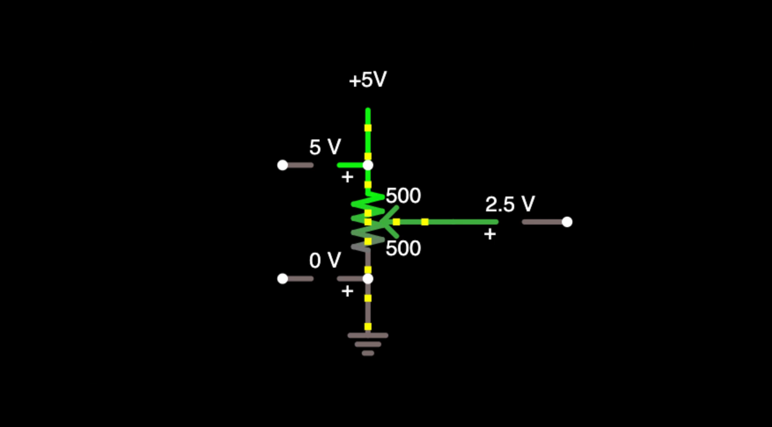


1kΩ potentiometer
Current is constant regardless of wiper position
R₁
Wiper contact
V_{out}
5V
$I= \frac{V}{R}= \frac{5V}{1kΩ}=5mA$
1
3
R₂
GND
Watch V_{out} change with the potentiometer wiper position.
Hence, why they call it a voltage divider.
V_{out} will follow the voltage divider equation:
$V_{out}=V_{in}∗\frac{R_{2}}{R_{1}+R_{2}}$

Slide 30
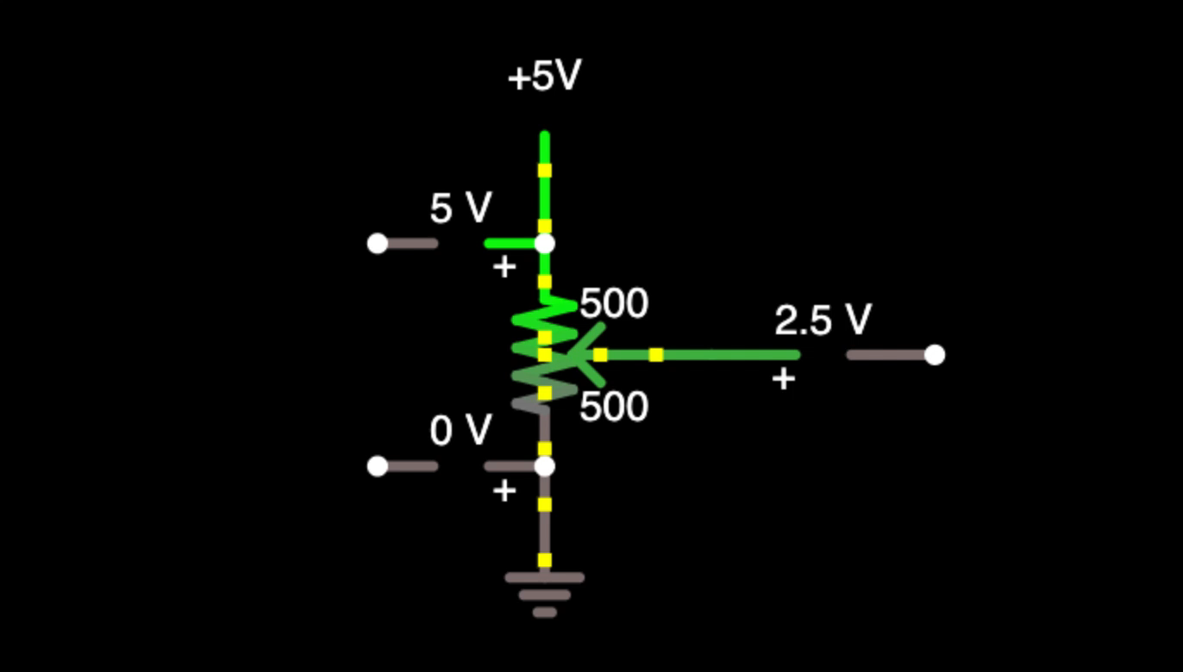

1KΩ potentiometer
Current is constant regardless of wiper position
V_{out}
$I= \frac{V}{R}= \frac{5V}{1kΩ}=5mA$
V_{out} will follow the voltage divider equation:
$V_{out}=V_{in}∗\frac{R_{2}}{R_{1}+R_{2}}$

Slide 31
5K
5V
0K
2.5K
5K
7.5K
10K
2.5K
7.5K
3
5V
`
`
0K
10K
3
GND
GND

